Slide 1

Journey through R - A motivating workshop
Introduction and Hands-On Examples

Slide 2
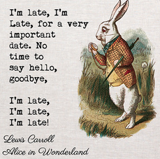
Workshop procedure Too much too little time - around 200 slides So many registered > 60 people
9th, 10th of May, 2025: theory
16th, 17th of May, 2025: cooking recipes, “hands on”
Relatively little interaction, more in the form of a monologue

Slide 3

Workshop procedure Too much too little time - around 200 slides
the slides can be used for reference and self-study
One long-term idea
Set up a student working group to improve you R skills if desired?
(IF time) conduct another “hands on” workshop?

Slide 4

Record my screen
Open Broadcaster Software (OBS) Overview:
OBS Studio is a free, open-source software used for video recording and live streaming.
Screen Recording:
I will only record the screen from my shared window and record my audio.
Intended Use:
For Internal Use Only: Screen recordings created with OBS are solely for internal documentation.
Goal:
A student will apply LLMs locally to
transcribe the audio file to text
to summarize the text
To write a documentation for students in the future about LLMs, something like https://www.uni-mannheim.de/media/Einrichtungen/Koordinationsstelle_Studieninformationen/Dokumente/Erstsemester/ChatGPT_Handreichung_Studierende_UMA_Stand_Mai_2023.pdf
Does anybody NOT want my split screen to be recorded?

Slide 5


Who am I?
EDUCATIONAL TRAINING
Sep 2015 – Sep 2018 Applied Statistics (M.Sc.), University of Göttingen
Sep 2012 – July 2015 Psychology (B.Sc.), Université de Fribourg (CH)
PROFESSIONAL TRAINING
Since April 2024 PostDoc Project in the DFG Research Training Group “Statistical Modeling in Psychology”, primary advisor Prof. Kiesel (University of Freiburg)
October 2020 – March 2024 PhD Project in the DFG Research Training Group “Statistical Modeling in Psychology”, primary advisor Prof. Kiesel (University of Freiburg)
Since Jan 2020 freelancer: coach for data analysis (supervision of bachelor, master and doctoral theses), private tuition on statistics

Slide 6
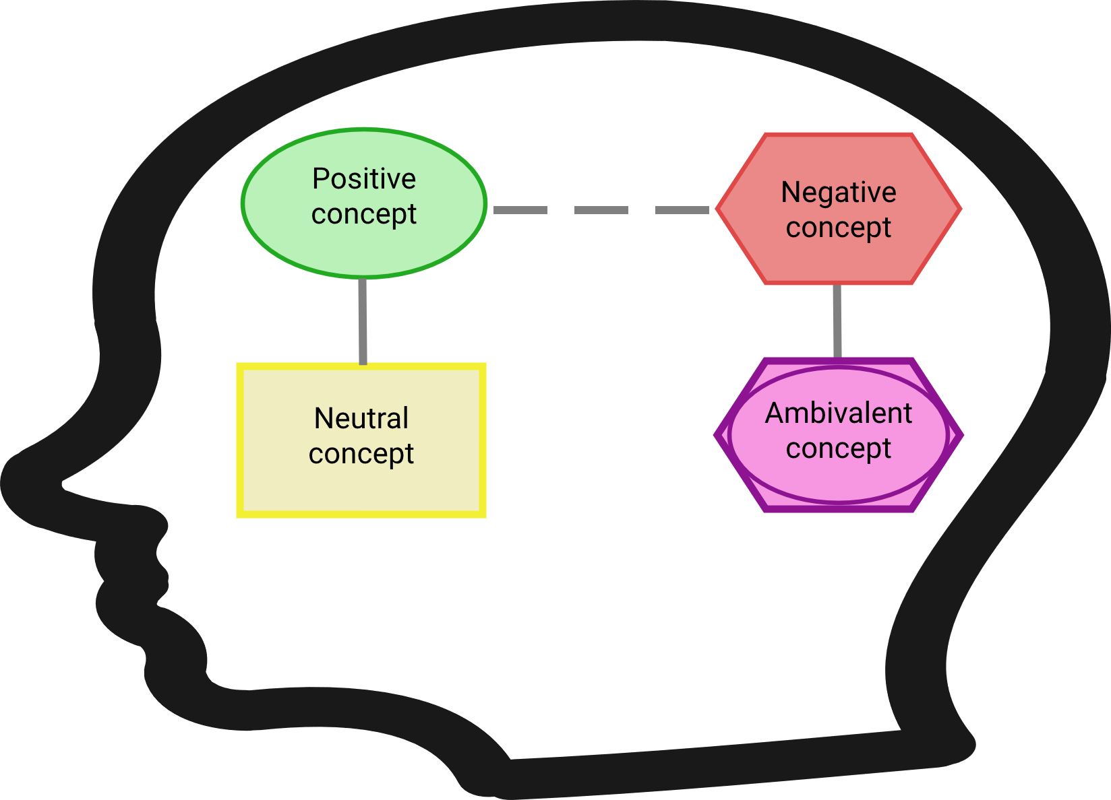
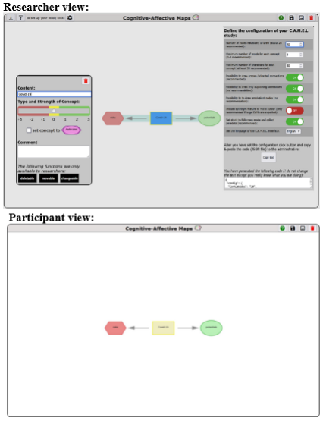
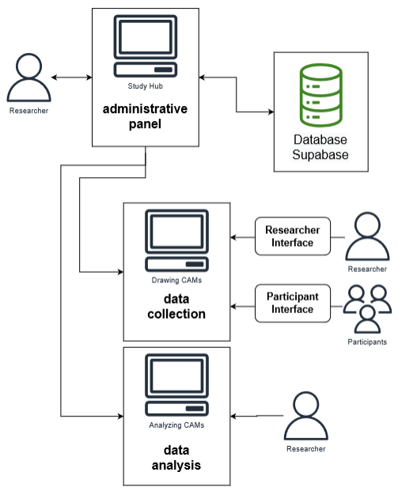
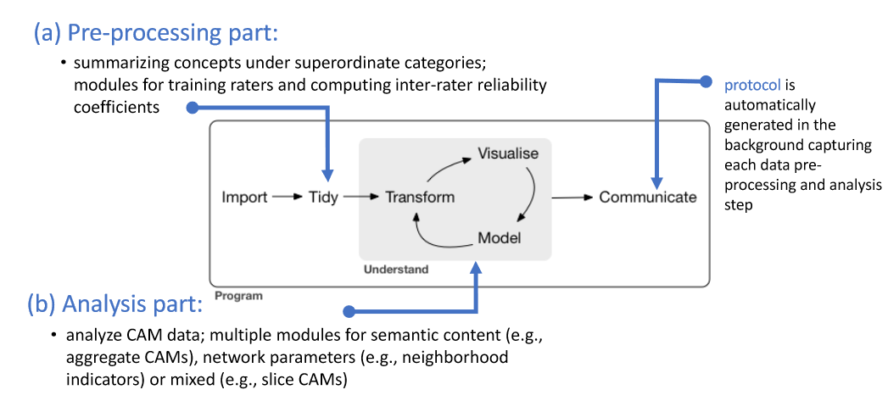
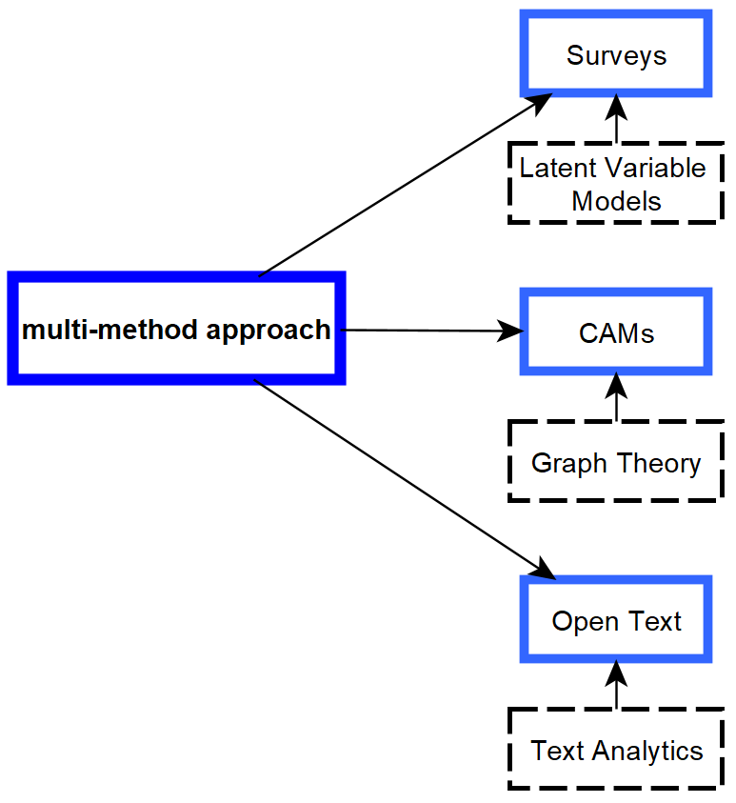
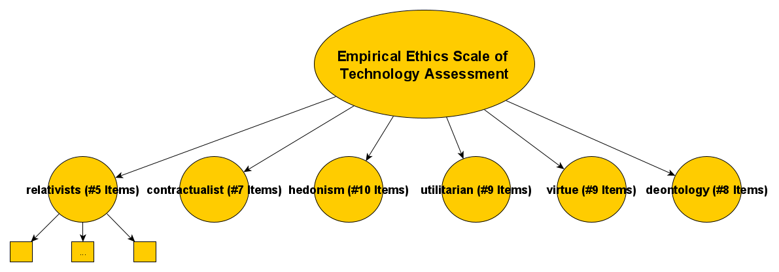
My research
Semantic Networks: Cognitive-Affective Maps extended logic: Proposing Tools to Collect and Analyze Attitudes and Belief Systems; https://drawyourminds.de/
Empirical Ethics: Development and Validation of an Empirical Ethics Scale for Technology Assessment - Challenges and Perspectives for a Real Time Ethics for Emerging Technologies
Prospective Technology Assessment: Propose methodologies to investigate (ethical) concerns of technologies at an early development stage.

Slide 7

Three announcements
1) We Are Hiring!
Looking for Student Assistants (with programming interest)
If you enjoy coding and want to gain hands-on experience, we are looking for motivated students to join our team as research assistants.
2) Bachelor’s / Master’s Thesis Opportunities
We are looking for motivated students who would like to complete their Bachelor’s or Master’s thesis with us.
If you enjoy coding and want to work on practical, research-driven projects, we offer exciting topics and close supervision to support your academic and professional development.
3*) For Students in the Psychology Master: Skill Project Opportunity
Get involved in an exciting project this year
You will have the chance to work with publicly available datasets.
Focus areas include social science data such as:
European Social Survey (ESS)
Armed Conflict Location & Event Data Project (ACLED)
The project will guide you through real-world data analysis, helping you build practical skills for your academic and professional career.
Example Project Outcome: https://rpubs.com/fennstat777/1293167

Slide 8
Evaluations of my previous R workshops
See: https://rpubs.com/fennstat777/1155605

